Slide 1
6 Ways to Think About ROC Curves
Robert M. Horton, PhD MS
Senior Data Scientist
Microsoft AI Platform Customer Engineering Team

Slide 2
Receiver Operating Characteristic
(ROC) Curve
A way to characterize sensitivity/specificity tradeoffs
for binary classifiers
that make quantitative predictions

Slide 3
Confusion Matrix for Binary Classifier
 |  | Predicted (from score)
 |  | + | -
Actual (label) | + | TP | FN
 | - | FP | TN
Notes:
The green boxes on the top-left to lower-right diagonal are the ones the test got correct. The red boxes are (type1 and type 2) errors.
Why can’t we just use a simple metric like accuracy (the fraction correct)? Consider when the outcomes are imbalanced, such as in a disease that affects 1% of the population, so 99% of patients are negative for disease. Then a bogus test that always comes back negative will have 99% true negatives and 1% false negatives, so it will be 99% accurate.
This is how cold cures work; almost everyone who takes the cure will get better, even if the cure does nothing.

Slide 4
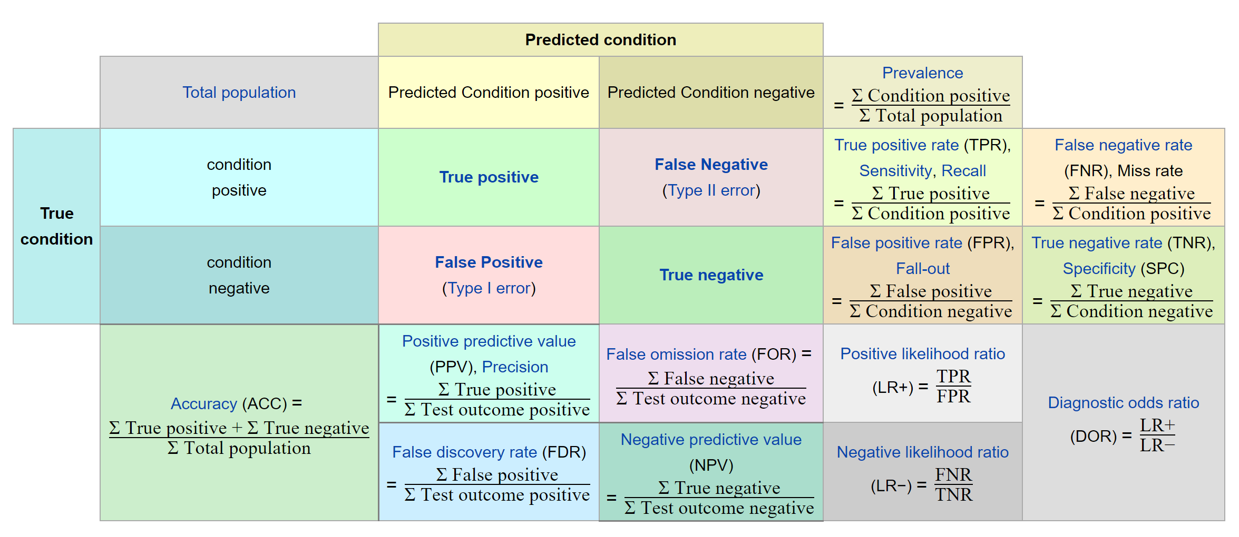
Wikipedia, Confusion Matrix
Notes:
This confusion matrix diagram is linked from many articles in Wikipedia, including those on “Sensitivity and Specificity”, and “Receiver Operating Characterisic”

Slide 5
6 Ways to Think About ROC Curves
The turtle’s view
Outcome Groups
Dueling cumulative density functions
Limit of the gain curve
Probabilistic interpretation
Mann-Whitney U-Test

Slide 6
ROC Curves 1
The Turtle’s view
A discrete view where labeled cases are sorted by score, and the path of the curve is determined by the order of positive and negative cases.
Examples are sorted by score.
Labels determine the path from lower left to upper right.

Slide 7
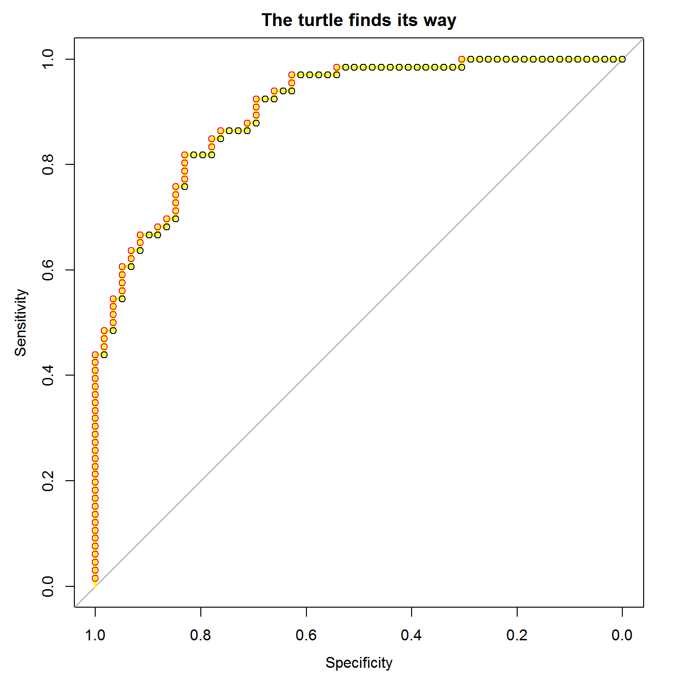
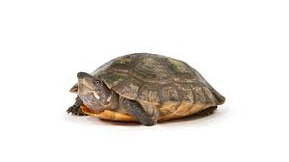
Simple ROC curves:
Think like a turtle
Sort the observed outcomes by their predicted scores with the highest scores first.
Calculate cumulative True Positive Rate (TPR) and False Positive Rate (FPR) for the ordered observed outcomes.
Plot TPR (Sensitivity) against FPR (1 – Specificity)
True Positive Rate
0.0 0.2 0.4 0.6 0.8 1.0
False Positive Rate
Notes:
This is the “turtle graphics” explanation from the first blog post. Once the cases are sorted by their scores, the turtle uses them to plot its course. Starting at (0,0) it reads the sorted labels. If it sees a positive one (red in this figure), it goes up. If it sees a negative(black) case it goes to the right. It scales its steps along each axis so that by the time it has seen all of the positive cases it will be at 1.0 on the y axis, and by the time it has seen all the negative cases it will be at 1.0 on the x axis.

Slide 8
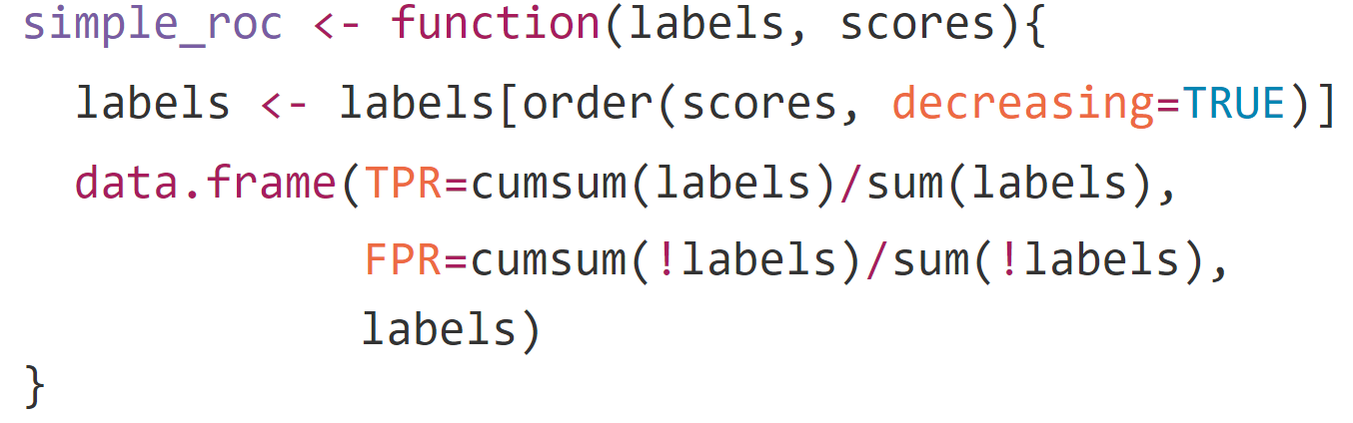
Two-step ROC calculation*:
* For educational use only
Notes:
sort cases by scores
calculate cumulative True Positive and False Positive rates from highest to lowest score
The ROC curve is a plot of TPR against FPR.

Slide 9
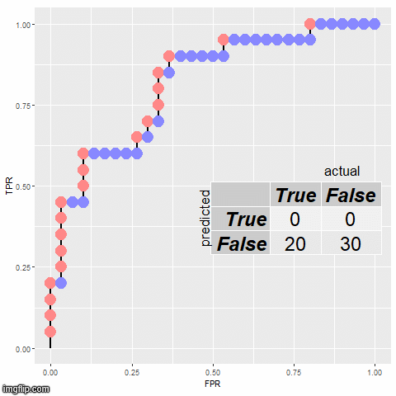
A confusion matrix represents a particular point on an ROC curve.
As the threshold scans past a case, it will move from the predicted False row to the predicted True row. Which column that case is in depends on whether it is actually True or actually False.

Slide 10
ROC Curves 2
Prediction by outcome group
This is a categorical view, where scores put cases in sortable buckets, or we need to handle tied scores.
Groups are ordered by score (e.g. fraction of positive predictions in training set).
FPR and TPR are calculated for each group.
Cumulative TP and FP rates are plotted against each other
  one point per group, connected by diagonals.

Slide 11
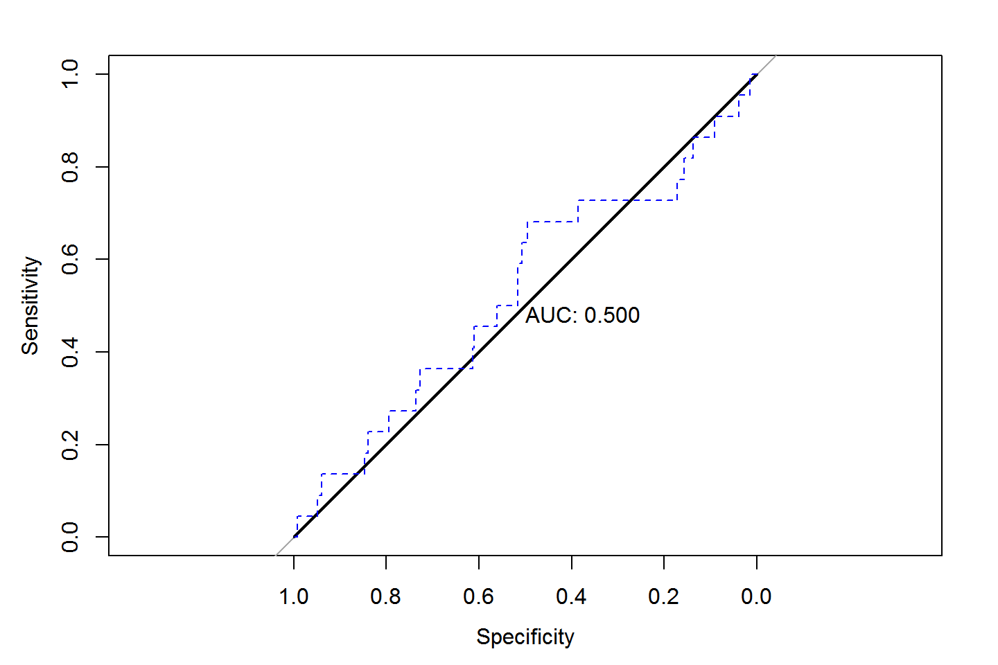
The simple approach does not correctly handle ties.
Multiple points with identical scores should be represented as diagonal segments.
Notes:
Here all points are given the same score. The black line correctly represents this situation with a diagonal. The turtle mistakenly thinks order matters, and traces out meaningless steps.

Slide 12
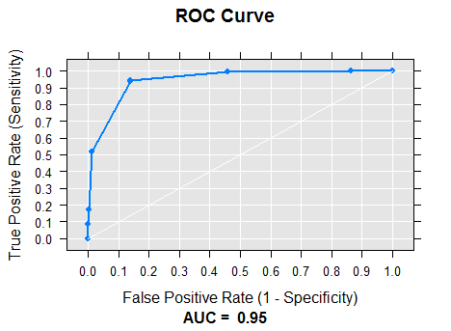
overweight
normal weight
underweight
mildly obese
moderately obese
severely obese
super obese
Notes:
This plot is from simulated data where body mass index is predictive of a disease (like diabetes, except that the real correlation is probably not this clean.)
When the predictor (BMI) is reported by group (super obese, severely obese, moderately obese, etc), all cases in that group have the same prediction; each group is represented by a diagonal line that connects to the cumulative (FPR, TPR) point representing the contribution of the entire group.

Slide 13
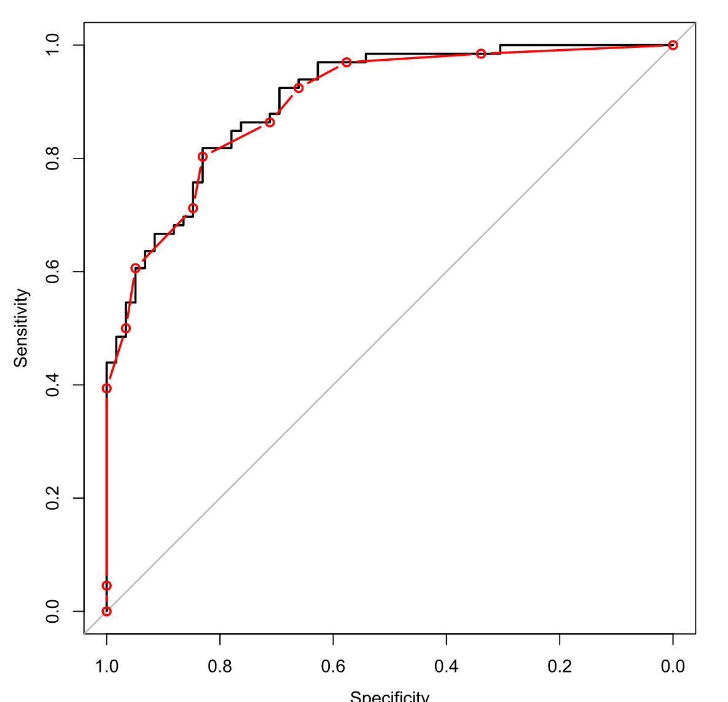
The black line shows high-precision scores, so each point has a unique score.
The red line uses rounded scores, so there are lots of ties.
Notes:
Rounding the scores also creates groups of cases with tied scores, and leads to diagonal lines in the ROC curve.

Slide 14
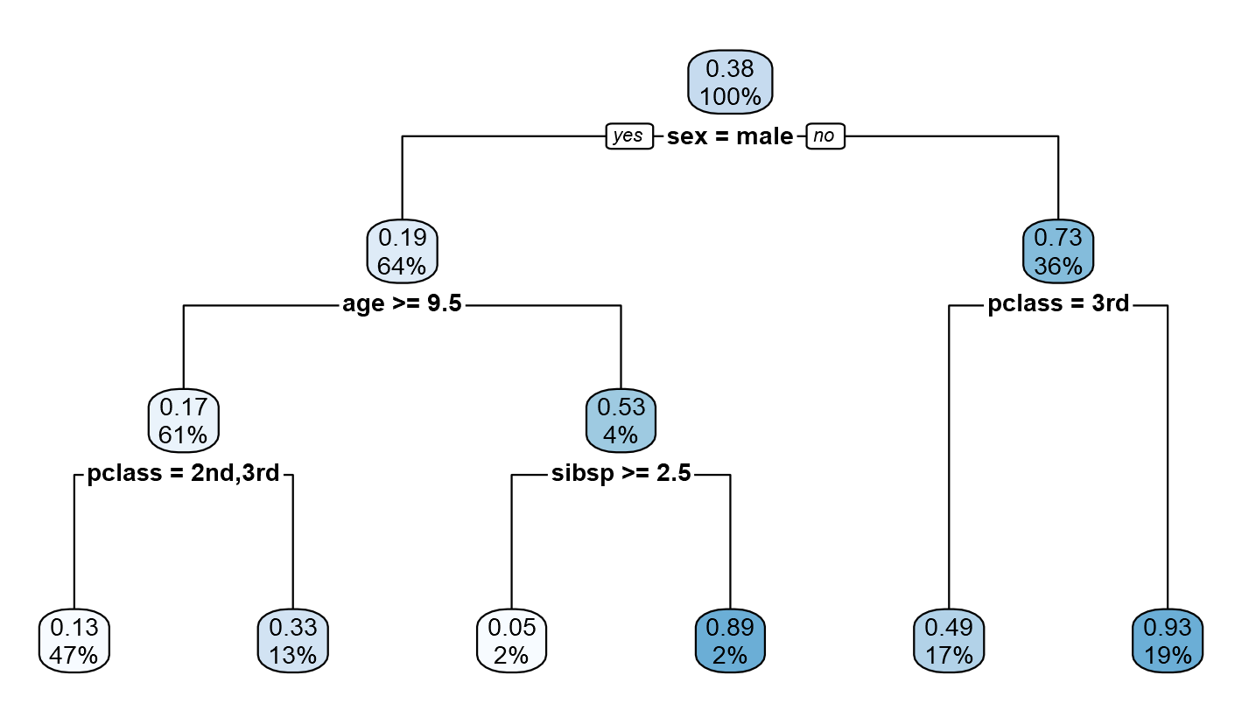
Notes:
Decision trees are a classical machine learning approach. All cases are placed into one of the leaves, and the predicted outcome for a new case is the average outcome that its leaf received in the training set.

Slide 15
ROC Curves 3
Dueling cumulative distribution functions
A continuous view, where the cumulative distribution function (CDF) for the positive cases is plotted against the CDF for the negative cases.
Positive and negative populations each have a distribution of scores.
Plotting the CDFs of the positives against that of the negatives other gives an ROC curve.
(screenshots from https://kennis-research.shinyapps.io/ROC-Curves/ )

Slide 16
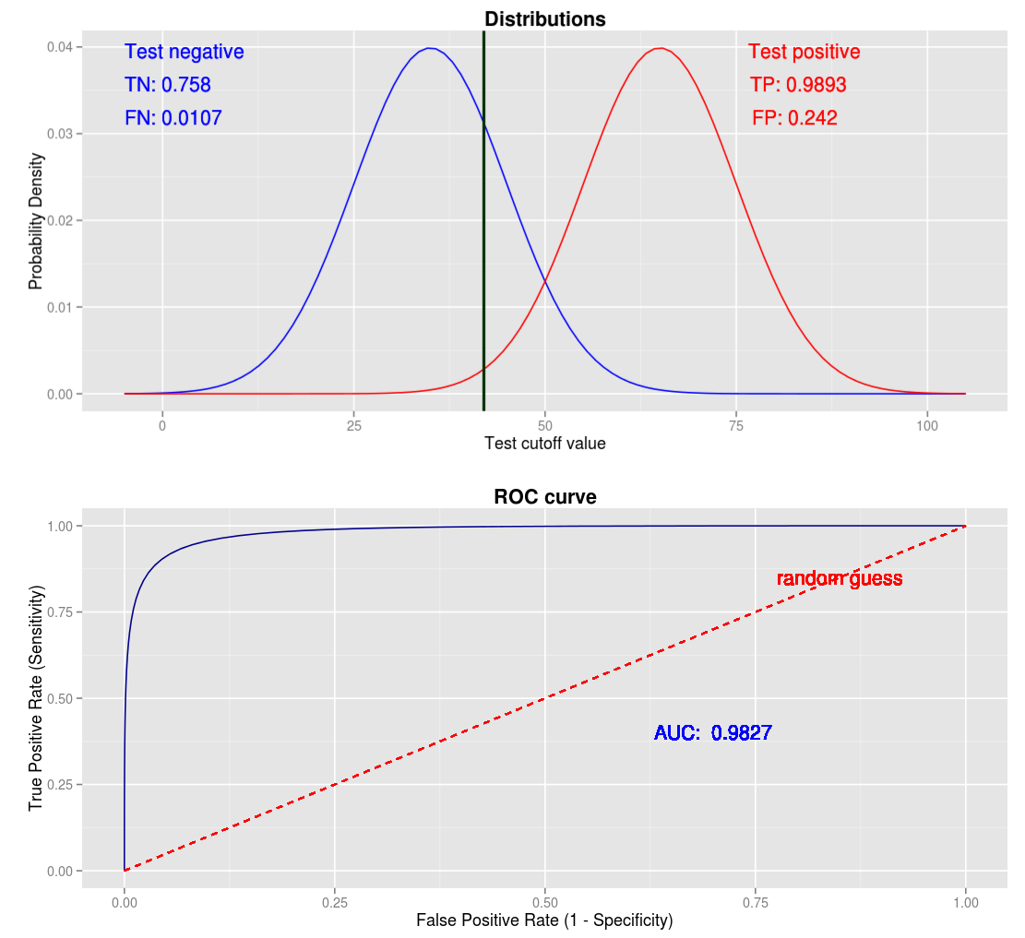
Notes:
# R code, in case you want to try this at home:
mu1 <- 38
sigma1 <- 4
mu2 <- 45
sigma2 <- 9
x <- seq(0, 80, length=1000)
y1 <- dnorm(x, mean=mu1, sd=sigma1)
y2 <- dnorm(x, mean=mu2, sd=sigma2)
plot(x, y1, type='l')
lines(x, y2, col="red")
## this is the ROC curve
plot(pnorm(x, mean=mu2, sd=sigma2), pnorm(x, mean=mu1, sd=sigma1), type='l')

Slide 17
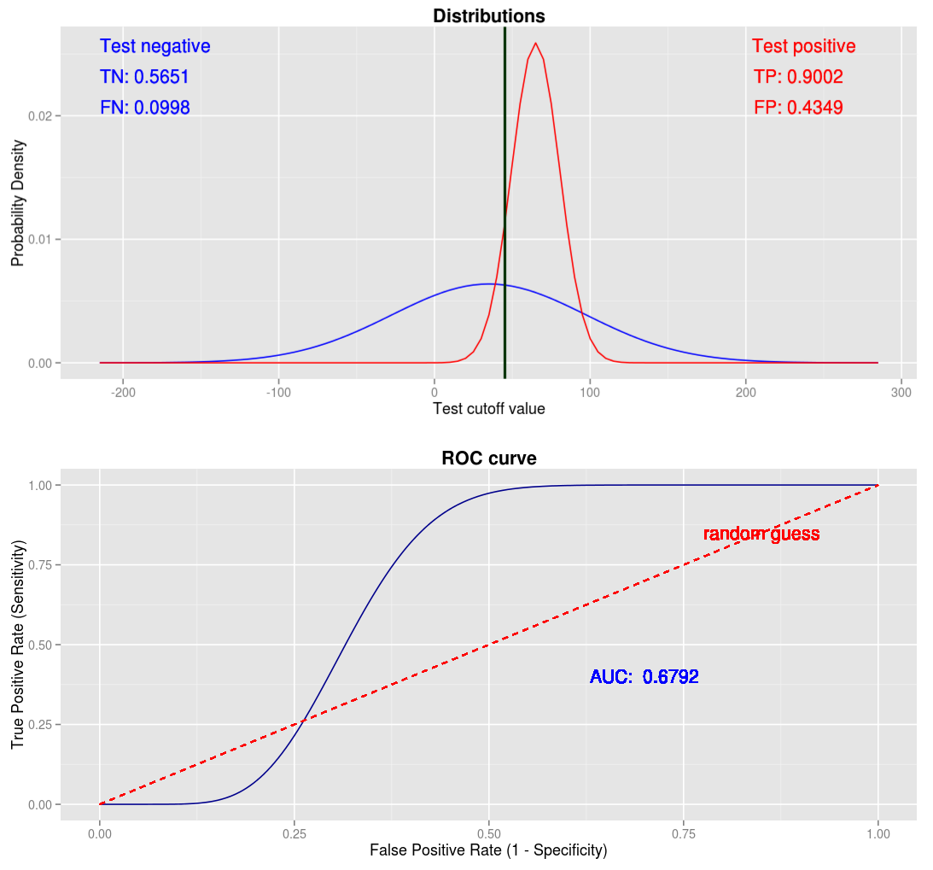

Slide 18
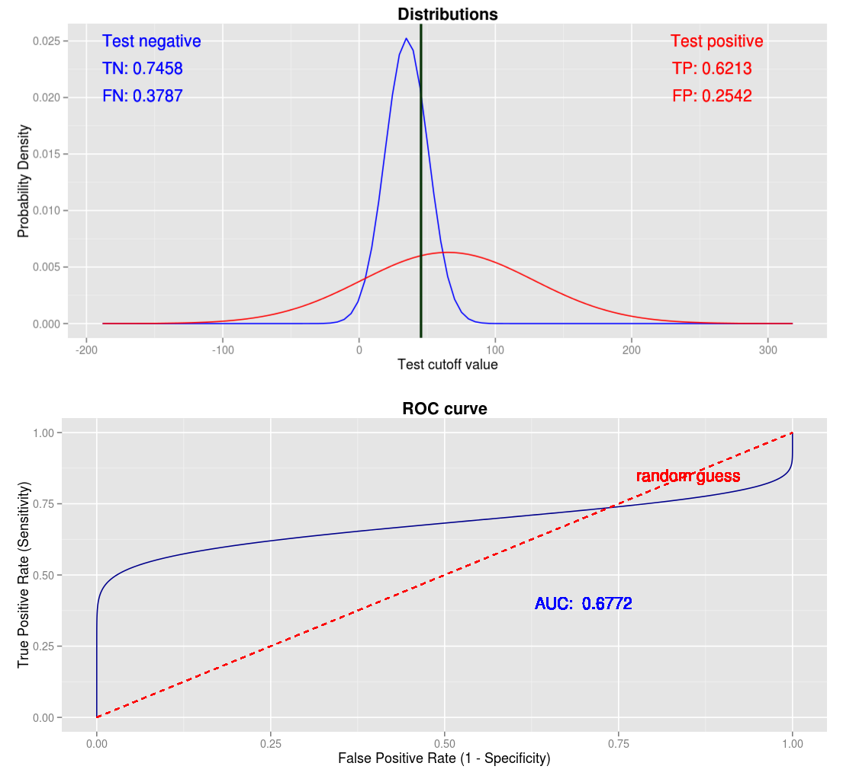

Slide 19
ROC Curves 4
Limit of the cumulative gain curve
The ROC curve can be thought of as the limit of the cumulative gain curve (or "Total Operating Characteristic" curve) as the prevalence of positive cases goes to zero.
Cumulative gain curve plots true positives against total population.
As the ratio of positives to negatives becomes smaller, the cumulative gain curve becomes more like an ROC curve.

Slide 20
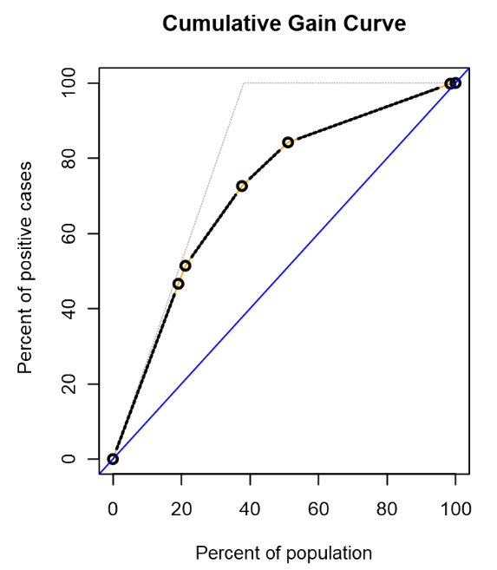
Notes:
This curve shows the results of survival on the Titanic. In a cumulative gain curve, the x-axis is the whole population, sorted with the highest scores on the left. The y-axis is the percent of the positive cases that have been discovered.
The faint gray line shows what the performance of a hypothetical perfect classifier would look like on this plot. Since 38% of the passengers survived, a perfect classifier would put all of the survivors in one group (who all survive), at the top 38% of the population, and everybody else in a second group (with no chance of survival). The light gray curve thus rises steadily for the first 38%, after which there are no more survivors to be found, and the curve goes flat. A “perfect classifier” plot always has two segments; a steeply rising part for positive cases, and a flat part for negatives.
The decision tree model is not perfect; there are some people in the highest-scoring group (though not many) who do not survive, and some in the lowest-scoring group who do survive (though not many). There are also several groups in between with very mixed outcomes.
If the proportion of positive outcomes were lower (say, if only 1% of the passengers survived), then the plot for the hypothetical “perfect classifier” would look more square (the part for the positive cases would be steeper) because all the positives are in a smaller part of the population. As the proportion of positive cases gets smaller, the cumulative gain curve looks more and more like an ROC curve.

Slide 21
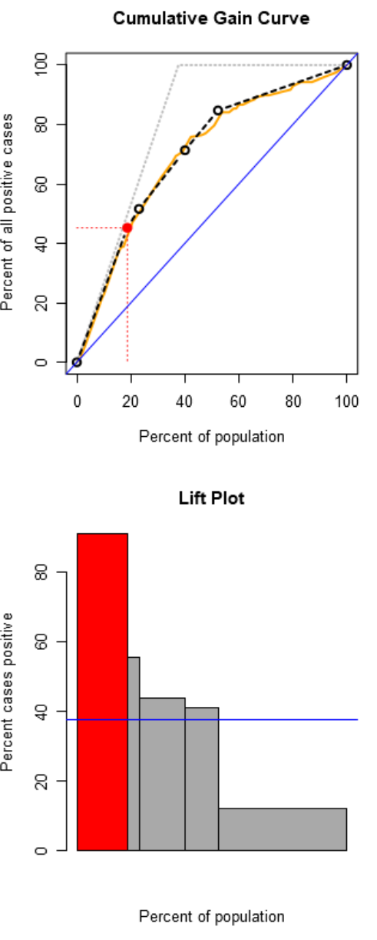
Notes:
This curve shows the results of survival on the Titanic. In a cumulative gain curve, the x-axis is the whole population, sorted with the highest scores on the left. The y-axis is the percent of the positive cases that have been discovered.
The faint gray line shows what the performance of a hypothetical perfect classifier would look like on this plot. Since 38% of the passengers survived, a perfect classifier would put all of the survivors in one group (who all survive), at the top 38% of the population, and everybody else in a second group (with no chance of survival). The light gray curve thus rises steadily for the first 38%, after which there are no more survivors to be found, and the curve goes flat. A “perfect classifier” plot always has two segments; a steeply rising part for positive cases, and a flat part for negatives.
The decision tree model is not perfect; there are some people in the highest-scoring group (though not many) who do not survive, and some in the lowest-scoring group who do survive (though not many). There are also several groups in between with very mixed outcomes.
If the proportion of positive outcomes were lower (say, if only 1% of the passengers survived), then the plot for the hypothetical “perfect classifier” would look more square (the part for the positive cases would be steeper) because all the positives are in a smaller part of the population. As the proportion of positive cases gets smaller, the cumulative gain curve looks more and more like an ROC curve.

Slide 22
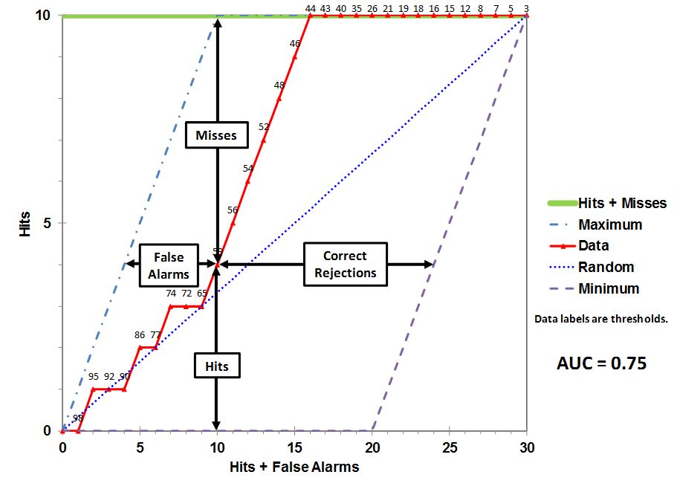
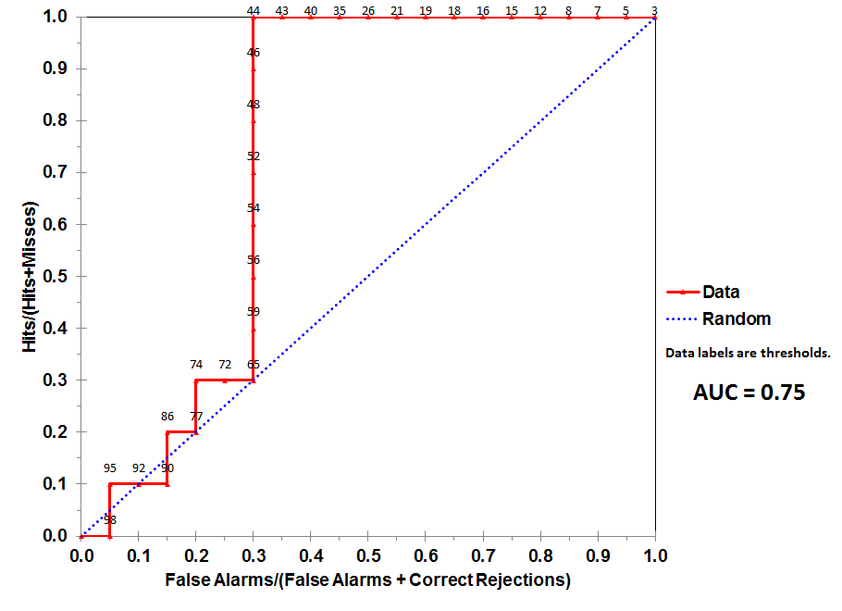
Total Operating Characteristic curve
TOC
ROC
https://en.wikipedia.org/wiki/Total_operating_characteristic

Slide 23
ROC Curves 5
Probabilistic interpretation
AUC is the probability that a randomly chosen positive case will have a higher score than a randomly chosen negative case.
We can construct a graphical interpretation that gives an ROC curve.

Slide 24
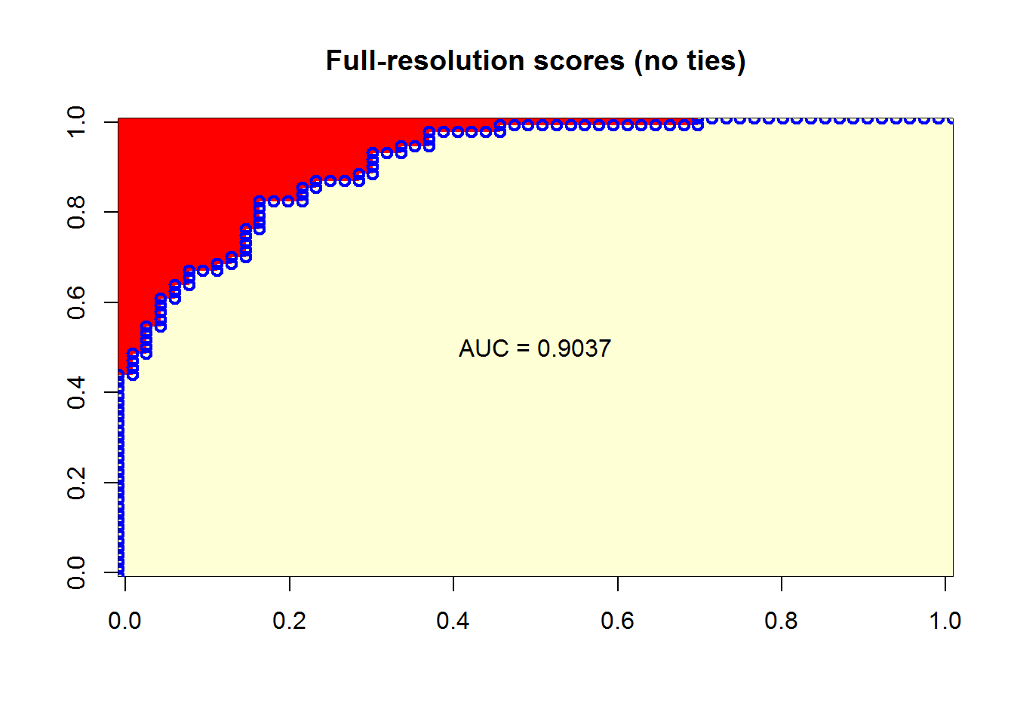
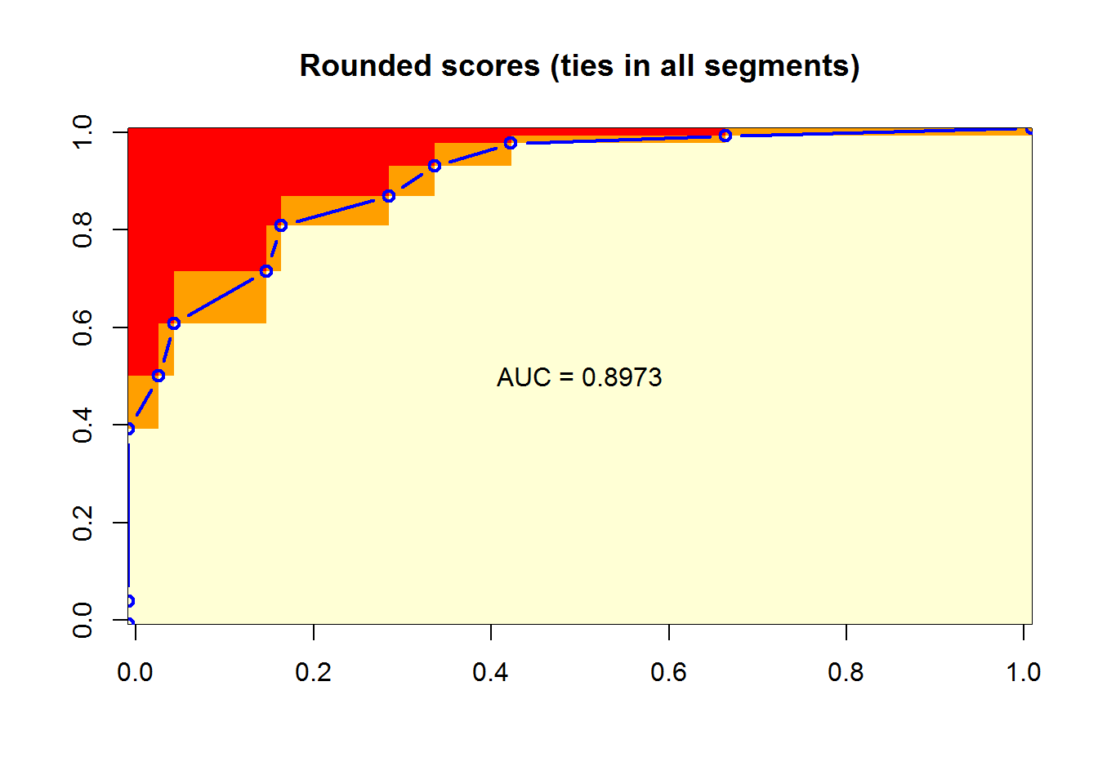
Full-resolution scores
(no ties)
Rounded scores
(includes ties)
Negative cases in columns
Positive cases in rows
Notes:
These are the plots from the blog post on “Calculating AUC” that illustrate how AUC relates to probability. On the left is the figure for the “full resolution” data, where there are no ties, and on the right is the figure for the dataset where scores have been rounded so that we have sets of cases with tied scores. In each figure we first generate a matrix where each row represents one of the positive cases, sorted so the highest score is in the row at the bottom. The columns in this matrix represent negative cases, sorted so that the highest score among these negative cases is at the left. Each cell in the matrix is assigned a value of 1 if the positive case for its row has a higher score than the negative case for its column, 0 if the positive case for the row has a lower score than the negative case for the column, and 0.5 if they are tied. The average value for the entire matrix is the AUC.
ROC curves were calculated using the standard method, and plotted on top of the image of the matrix (after a little scaling and shifting to get the points to line up with the edges of the cells…)
This approach for finding (and visualizing) the AUC should make the probabilistic interpretation clear: AUC is the probability that a randomly chosen positive case will have a higher score than a randomly chosen negative case.

Slide 25
ROC Curves 6
The Mann-Whitney Wilcoxon U Test Statistic
The ROC curve emerges from a graphical interpretation of the
Mann-Whitney Wilcoxon U Test Statistic, which illustrates how AUC relates to this commonly used non-parametric hypothesis test.
“Robust” alternative to the t-test.
The formula has a graphical interpretation that gives the ROC curve.

Slide 26
How well does your classifier separate the classes?
Is the ordering of red and black dots random?
Notes:
plot(1:nrow(glm_simple_roc), rep(1, nrow(glm_simple_roc)), col=1+glm_simple_roc$labels, bg=1+glm_simple_roc$labels, pch=21)
plot(1:nrow(glm_simple_roc), rep(1, nrow(glm_simple_roc)), col=2*glm_simple_roc$labels, bg=2*glm_simple_roc$labels, pch=21)
col <- ((glm_simple_roc$labels+1) %% 2)
plot(1:nrow(glm_simple_roc), rep(1, nrow(glm_simple_roc)), col=col, bg=col, pch=21)

Slide 27
category <- c( 1, 1, 1, 1, 0, 1, 1, 0, 1, 0, 1, 0, 1, 0, 0, 1, 0, 0, 0, 0)
prediction <- c(20,19,18,17,16,15,14,13,11.5,11.5,10, 9, 8, 7, 6, 5, 4, 3, 2, 1)
library('pROC')
(official_auc <- auc(roc(category, prediction)))
## Area under the curve: 0.825
auc_wmw <- function(labels, scores){
labels <- as.logical(labels)
pos <- scores[labels]
neg <- scores[!labels]
U <- as.numeric(wilcox.test(pos, neg)$statistic)
U/(length(pos) * length(neg))
}
auc_wmw(category, prediction) # 0.825
Notes:
This is the simple data set we use for most of the examples in the blog post. The `prediction` vector holds the fake scores, which are just assigned so that the cases will be ranked in the order they started with. We add a minor complication by having two of the cases (one positive and one negative) have tied scores.
In the first pass at a function to use this relationship to calculate AUC from the U statistic we just take the statistic value from the result of the `wilcox.test` function. We get the same AUC value as the “official” version on the previous slide.

Slide 28
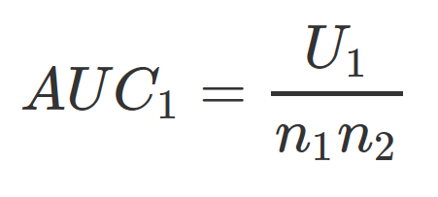
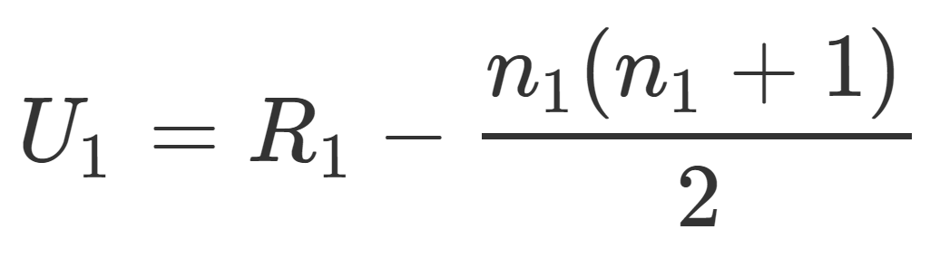
auc_wmw2 <- function(labels, scores){
labels <- as.logical(labels)
n1 <- sum(labels)
n2 <- sum(!labels)
R1 <- sum(rank(scores)[labels])
U1 <- R1 - n1 * (n1 + 1)/2
U1/(n1 * n2)
}
auc_wmw2(category, prediction) # 0.825
Notes:
This is the next version of a function to compute AUC using the U statistic formula. Here we calculate the U statistic directly. It still works.

Slide 29
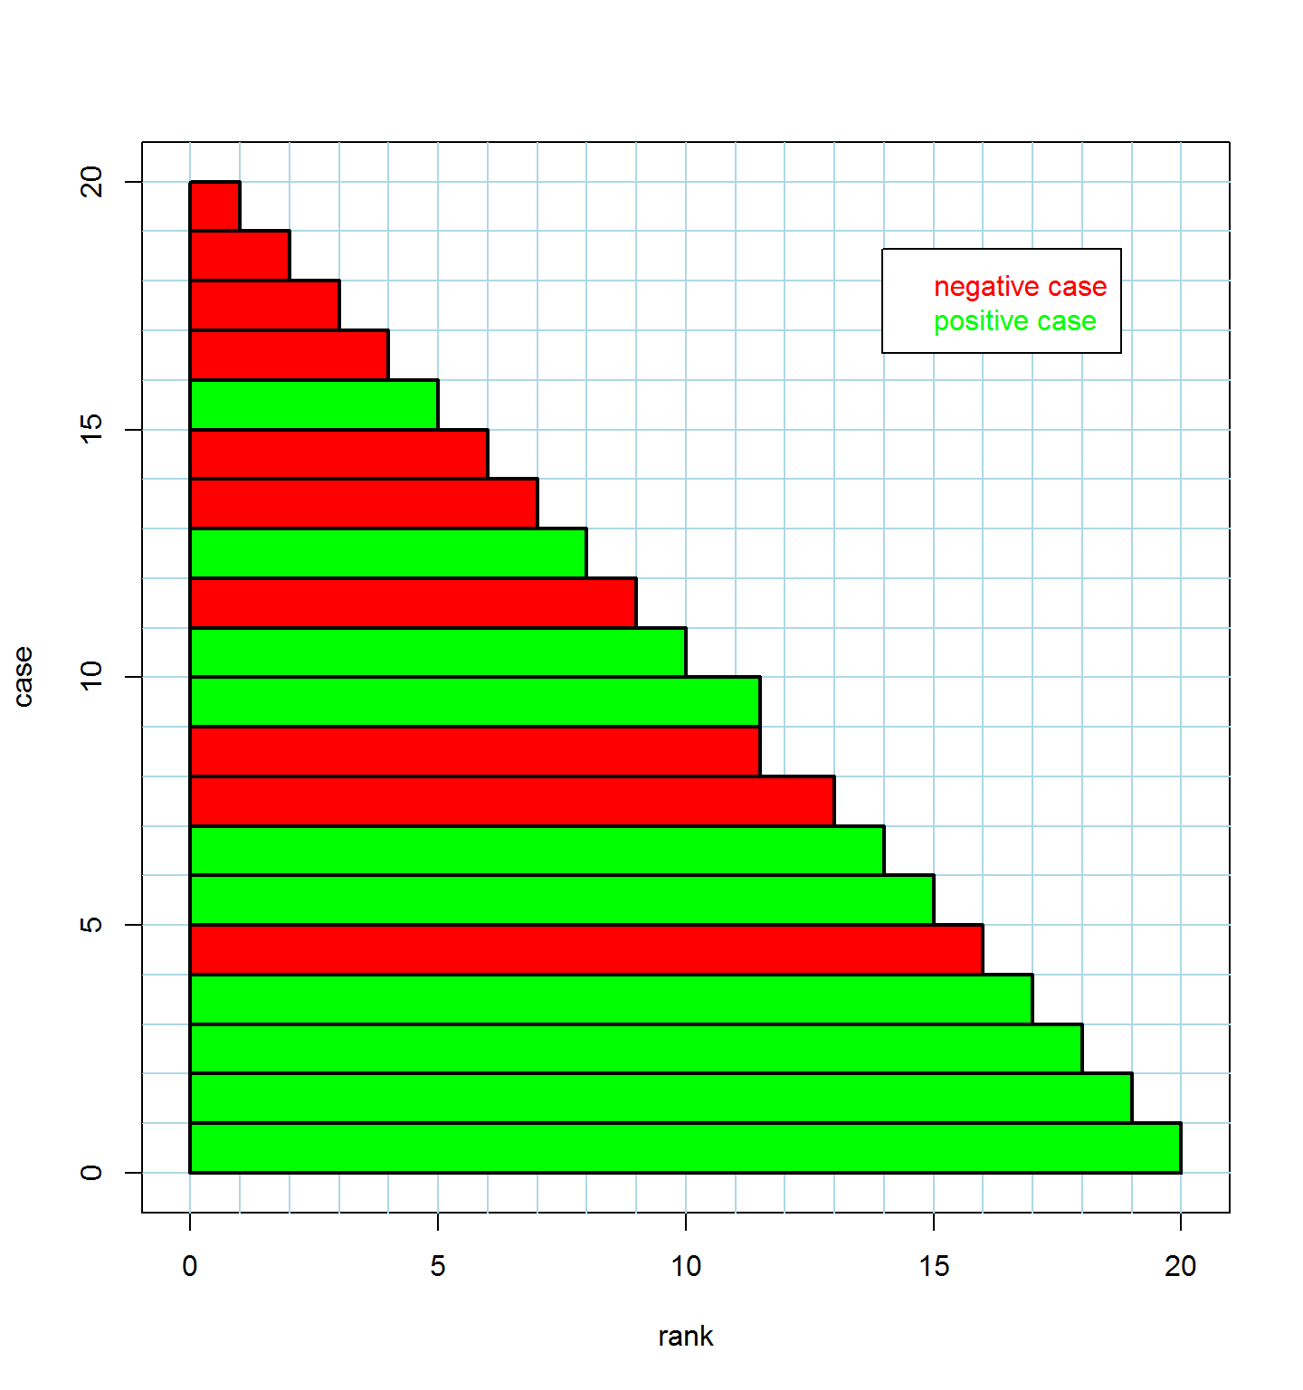
rank label
1.0 0
2.0 0
3.0 0
4.0 0
5.0 1
6.0 0
7.0 0
8.0 1
9.0 0
10.0 1
11.5 0
11.5 1
13.0 0
14.0 1
15.0 1
16.0 0
17.0 1
18.0 1
19.0 1
20.0 1
case
Notes:
This is a graphical representation of the rank-ordered data. Each case gets a bar of height 1, and width determined by its rank. The bars are colored by the label (red for negative or green for positive).
If you look closely you’ll see that the ranks in this example are the same as the `prediction` values we started with. Maybe the difference would be more clear if we divided the prediction values by 10 or something…

Slide 30
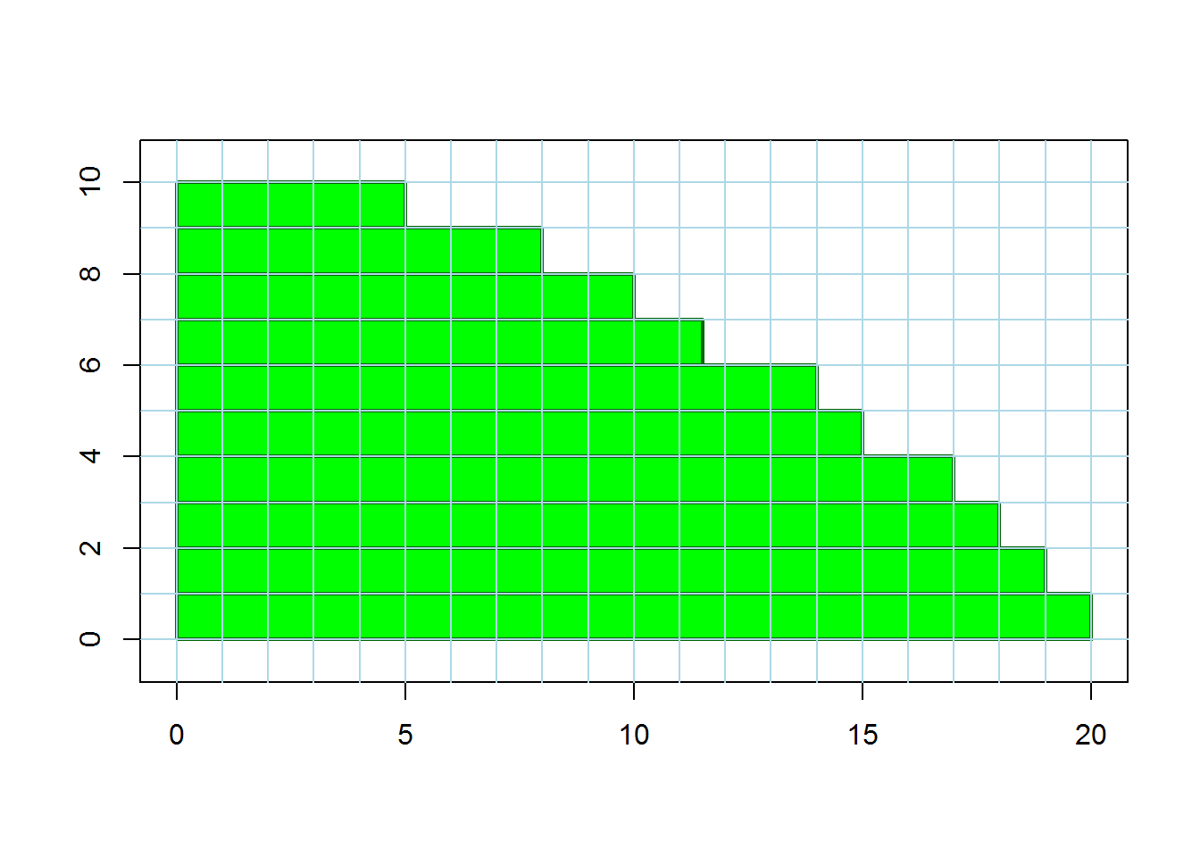
R₁
Notes:
We remove the red bars and are left with a stack of green ones. The total area of green is equal to R1, the sum of the ranks of the positive cases.

Slide 31
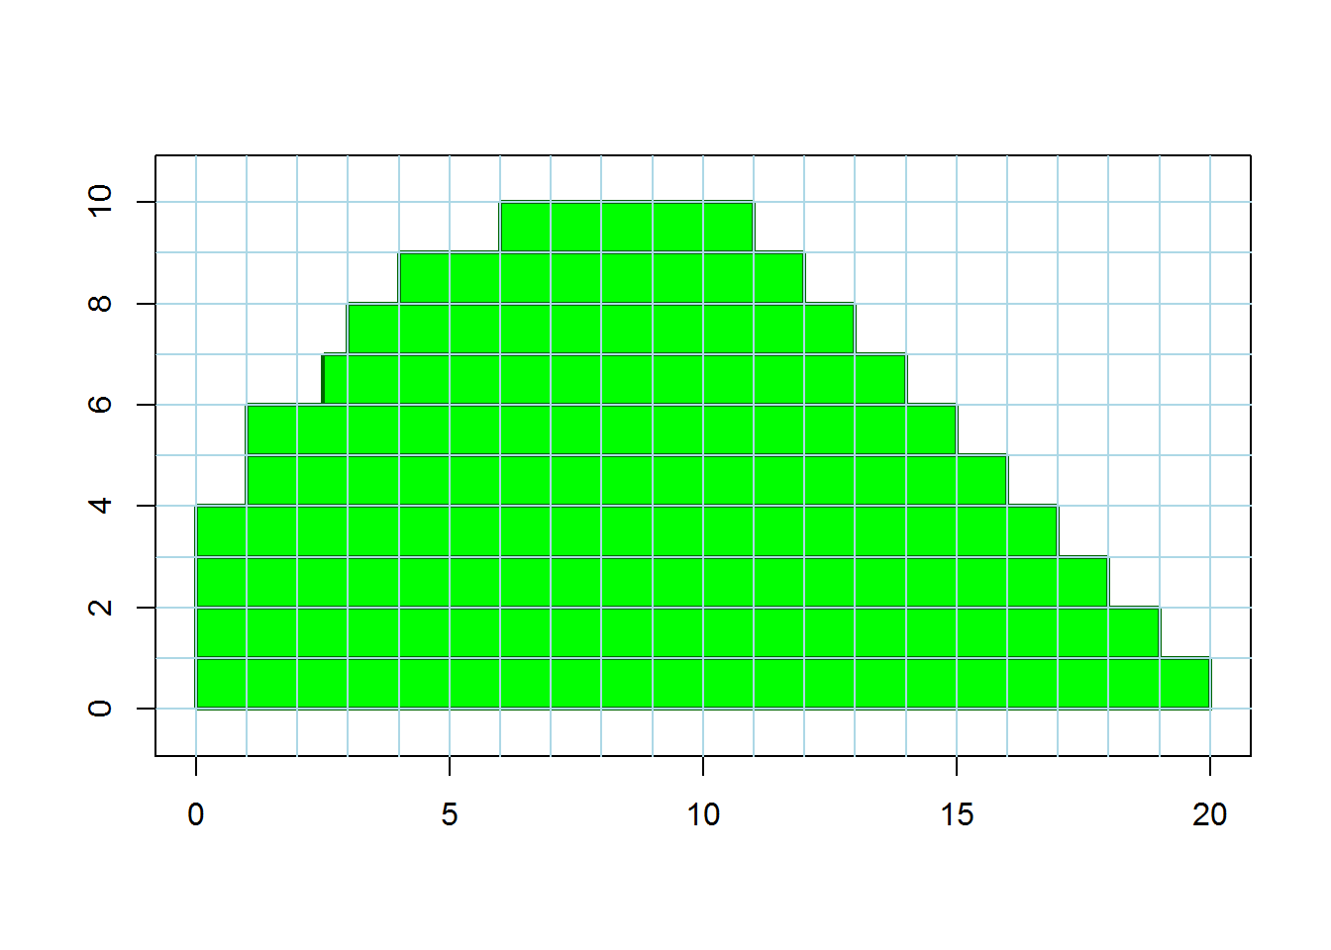
R₁
Notes:
Here we’ve slid the bars so that the right edge forms a perfect stairstep pattern. The area remains the same (still equal to R1).

Slide 32
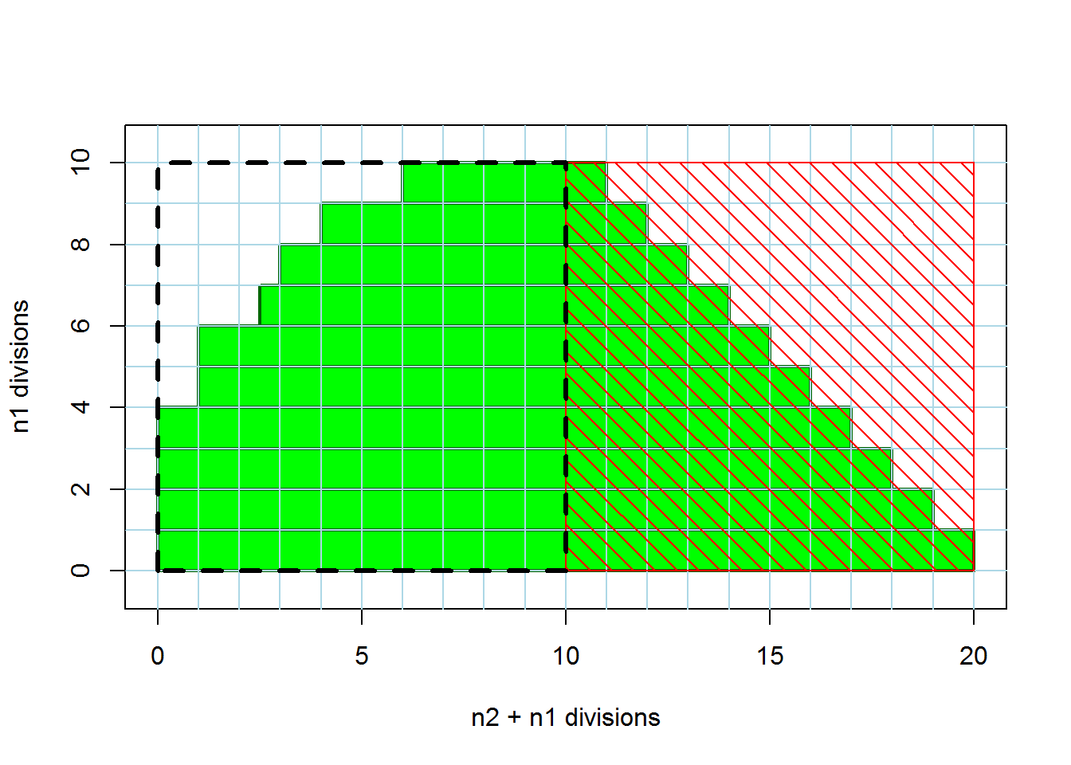
n₂
n₁
R₁
n₁
Notes:
If we subtract the area under the hatched red square, we are left with U1, the Wilcoxon-Mann-Whitney U statistic.
In this example n1 and n2 are both equal to 10, so both the red hatched area and the black dashed area are squares. But the black dashed area will only be square if n1 and n2 are equal.

Slide 33
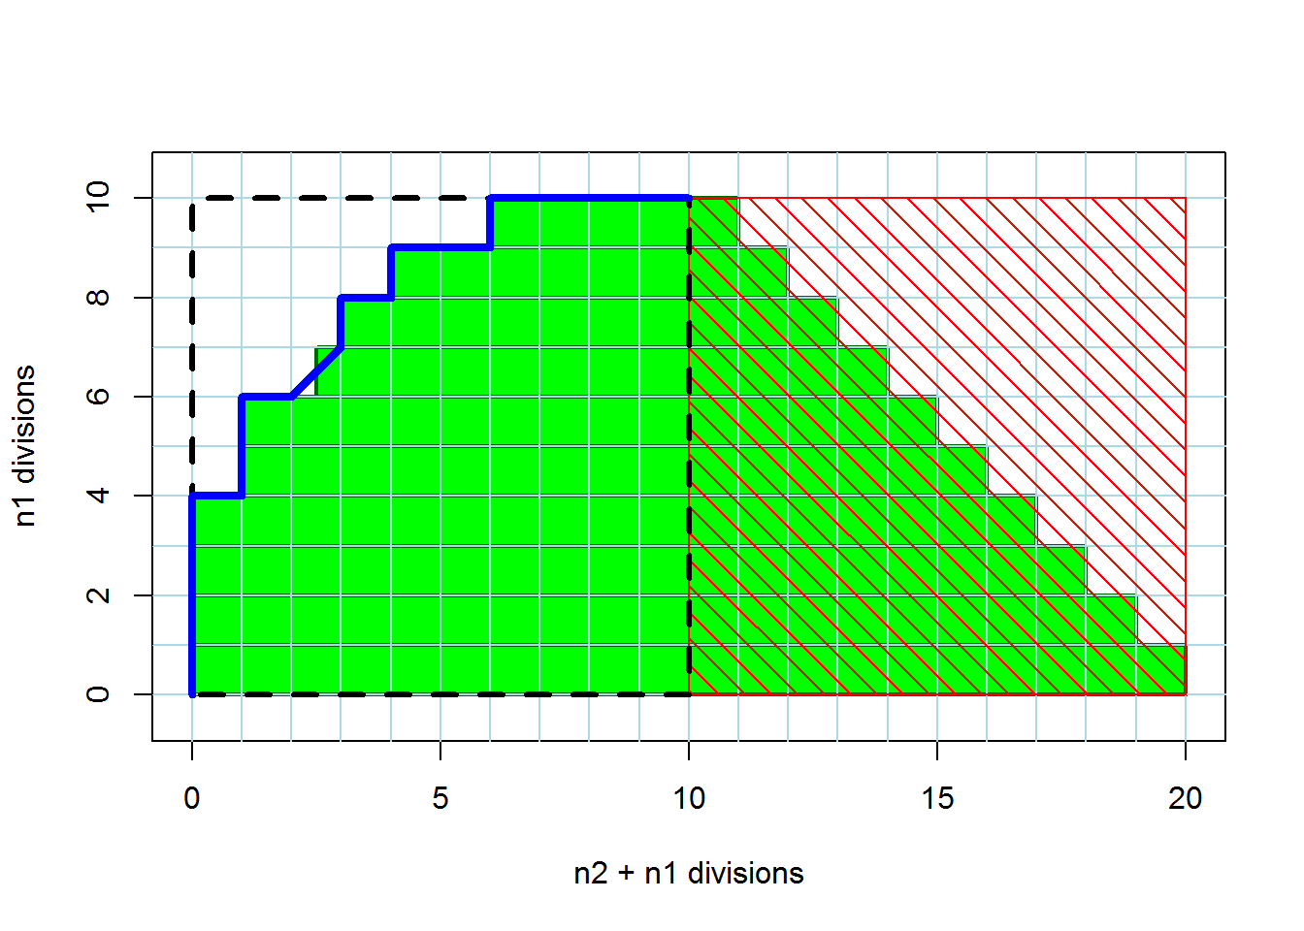
n₂
Scaled ROC curve
n₁
Notes:
Here we’ve independently calculated an ROC curve for this dataset, re-scaled it so that the true positive rate ranges from 0 to n1 (originally it would range from 0 to 1), and the false positive rate ranges from 0 to n2. When we plot it on top of this figure, it follows along the left edge of our stacked bars, except where the ties occur in the dataset. But we can see that the area of U1 is equal to the area under the scaled ROC curve. That square that differs is split in half diagonally by the ROC curve and vertically for the green bars, but it is still divided exactly in half in both cases.
To calculate AUC from U1, we go the other way, scaling U1 down as a fraction of the n1 * n2 black dashed area.

Slide 34
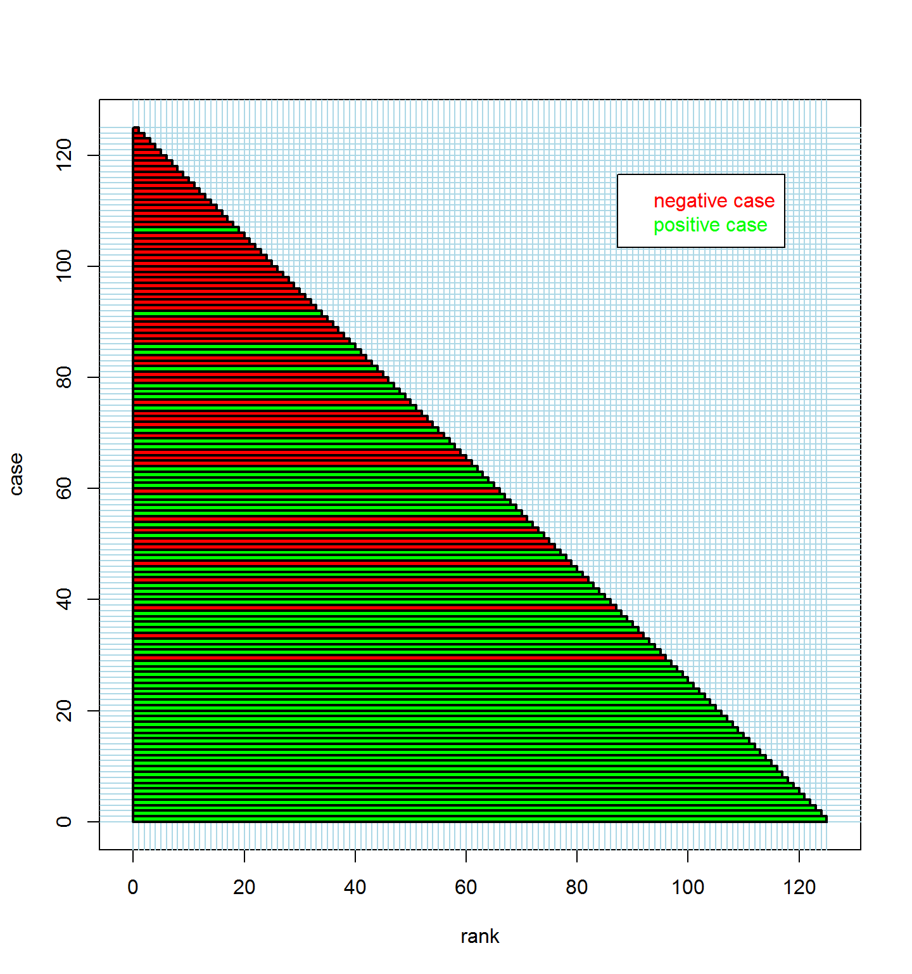
Notes:
This example is on a bigger dataset, with no ties.

Slide 35
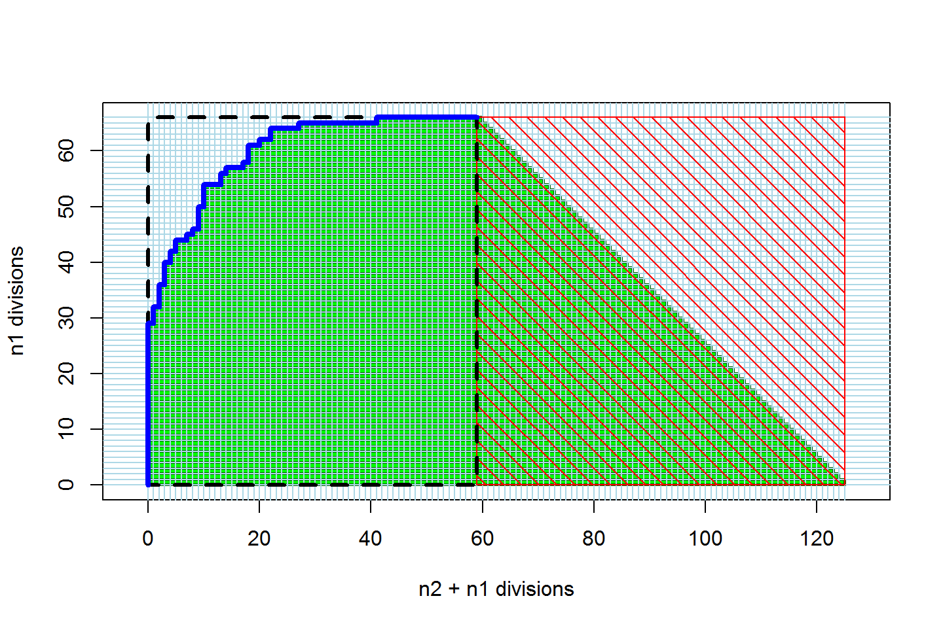
Notes:
Since there are no ties, the left edge of the stack of green bars forms a perfect (scaled) ROC curve.
We may have invented the world’s most complicated way to draw an ROC curve!

Slide 36
Funny-Looking ROC Curves

Slide 37
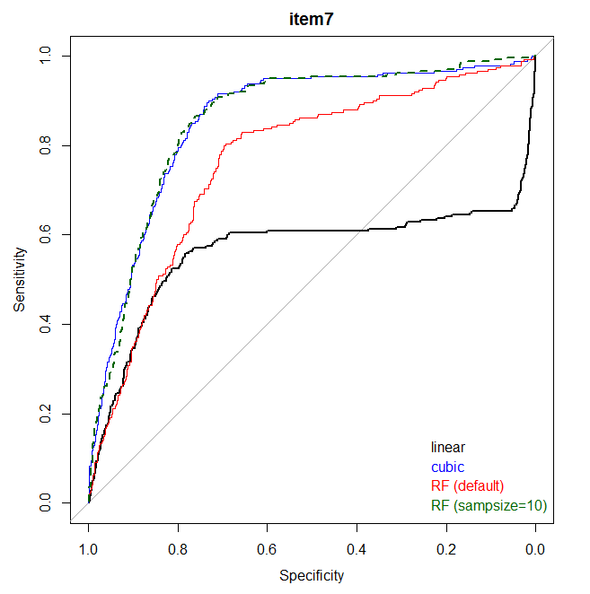
Notes:
This is from simulated data where y is a cubic function of x.
The black line is the ROC curve for a linear model fitted to y ~ x. The blue line is for a cubic model fitted to a cubic polynomial of x. The green and red lines represent random forest models with different hyperparameters.

Slide 38
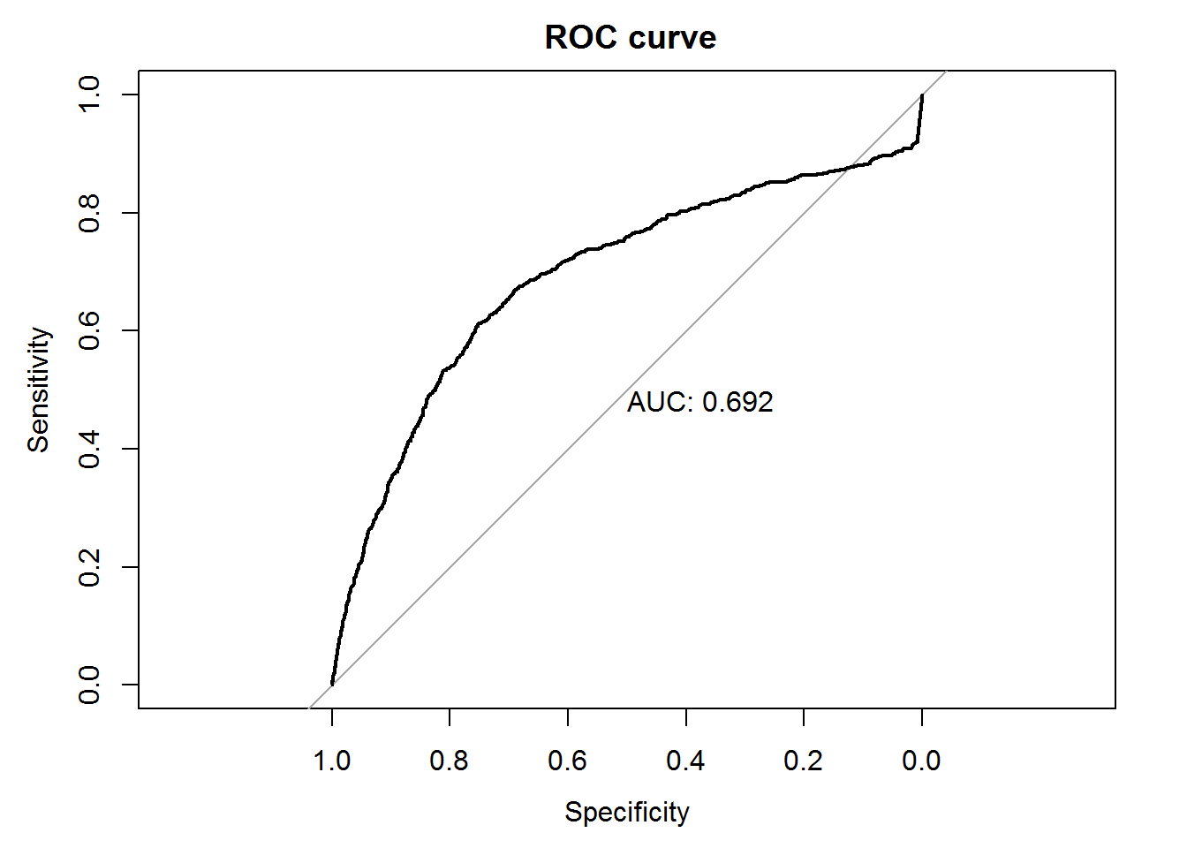
FLC IRL
Notes:
This is a “Funny Looking ROC Curve In Real Life”: it was from a bug in a machine learning implementation where perfect scores got converted to zeros. This put the very best cases at the end, where the very worst cases should be.

Slide 39
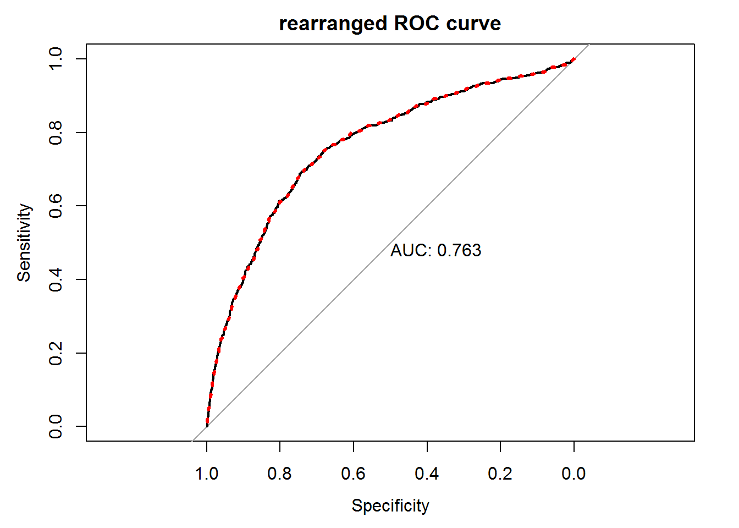
Notes:
Changing the zero scores to ones put the very best cases at the beginning, and gave a better-looking ROC curve (note that this is on the test set, so it was a way of patching the algorithm).

Slide 40
Bob’s Revolutions blog posts on ROC curves:
ROC Curves in Two Lines of R Code
Calculating AUC
AUC meets the Wilcoxon-Mann-Whitney U Statistic
Notes:
See more details in the posts at http://blog.revolutionanalytics.com/

Slide 41
Further Reading
Fawcett, T. An Introduction to ROC Analysis (Pattern Recognition Letters 27; 861–874, 2006)
Berrizbeitia, L. Receiver Operating Characteristic (ROC) Curves (Shiny App)
Kanchanaraksa, S. Evaluation of Diagnostic and Screening Tests: Validity and Reliability (Johns Hopkins)
Kruchten, N. ML Meets Economics (blog post)
Mount J and Zumel N. The Win-Vector blog.

Slide 42

Thank You
turtleconservancy.org

